Slide 1

PowerBI + SQL Portfolio Project
An Overview into the process

Slide 2



Project Aims
With PowerBI containing a whole suite of data importation options, there are a lot of opportunities to interweave it around your data analysis workflow. My aim through this project was to make use of a MYSQL structured database and deliver it to PowerBI for analysis, performing important ETL (Extract, Transform, Load) processes to get it cleaned and ready for analysis. PowerBI’s tools allow me to perform descriptive, diagnostic and predictive analysis through the use of forecasts, for instance.

Slide 3
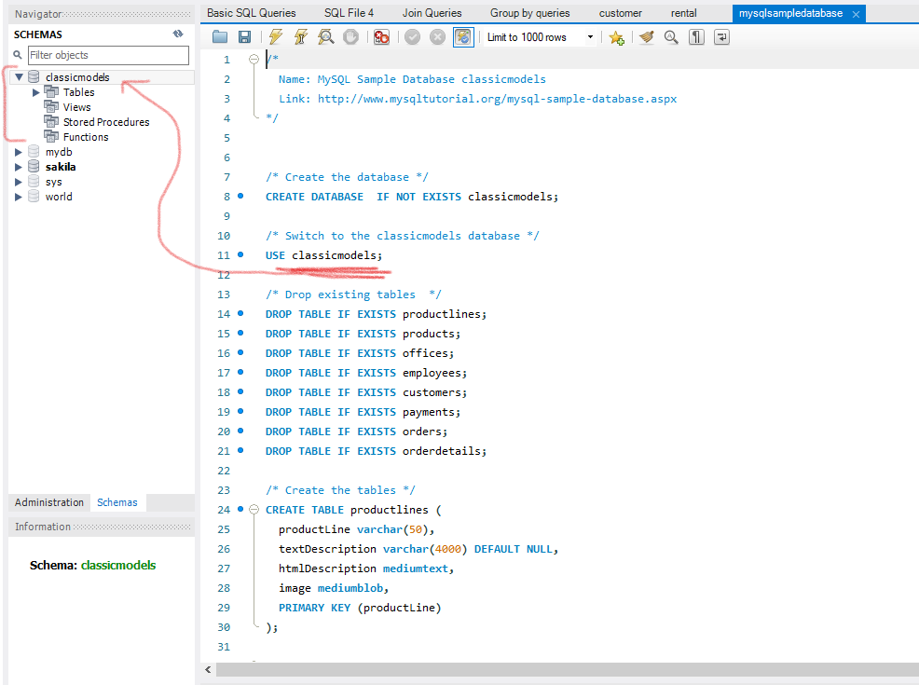
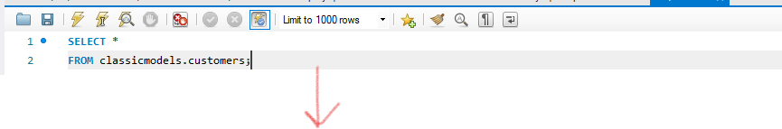
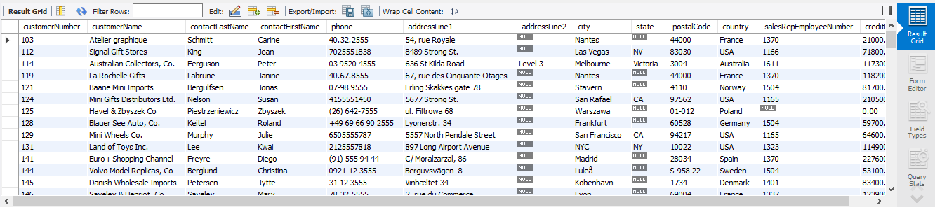
MYSQL Database Download
As this database was sourced online, I needed to first run a query to get the contents of that database into my local MYSQL server. There was an SQL query I could use to directly import it so I could then take the data forward and into my PowerBI workspace. If I were to run a SELECT query on one of the tables in this schema, I could see all of the entries.

Slide 4
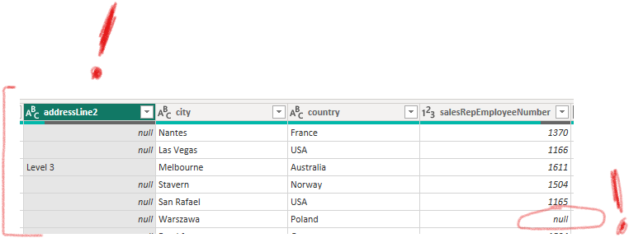
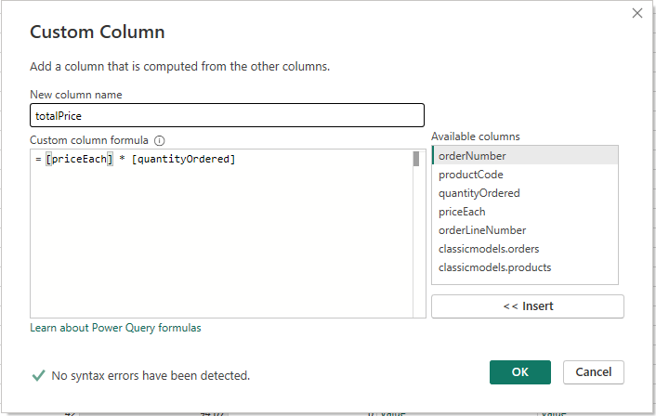
ETL Process
While the database was largely well made, there are some parts of the database that I will not require for this, which I can safely remove. However, I also noticed null values pertaining to customers not being linked to a sales representative. Null values such as these propagate into my analyses, making a portion of my sales untraceable to any of the offices in the business. However, I couldn’t remove them as they make up a substantial portion of the statistics, presenting a unique situation.
On the side of order details, I saw fit to add a calculated column for the total price of an order, collected by multiplying the price each by the quantity as each order covered a single type of item.

Slide 5
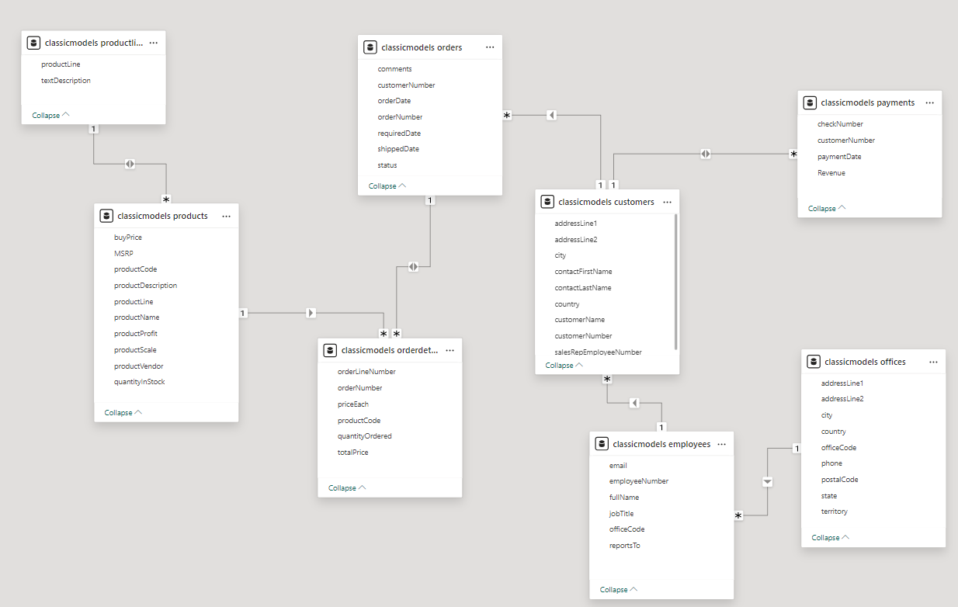
Star Schema
The ClassicModels relational database is comprised of a star schema with relationships that allow me to create analyses using fields from seemingly distant unrelated tables, such as with tracing every customer order to the salesperson and office that managed them.

Slide 6
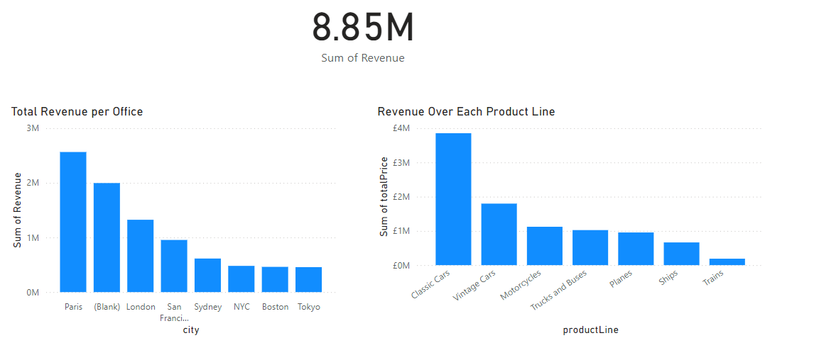
Descriptive Analysis
What are the total revenues generated across all offices in the past year, broken down by office location?
This column chart clearly highlights the Paris office as the peak performer, with London second and San Francisco third. Tokyo is the weakest in terms of the generation of revenue. A large amount of revenue is untraceable due to a lack of linked representatives in the orders, appearing as ‘(Blank)’.

Slide 7
Descriptive Analysis
Which product lines generated the highest and lowest revenue in the last year?
Classic Cars is an overwhelmingly large portion of the revenue gained by the company, more than twice as large as the next most profitable, Vintage Cars. Meanwhile, Trains are the weakest performing in this regard.

Slide 8
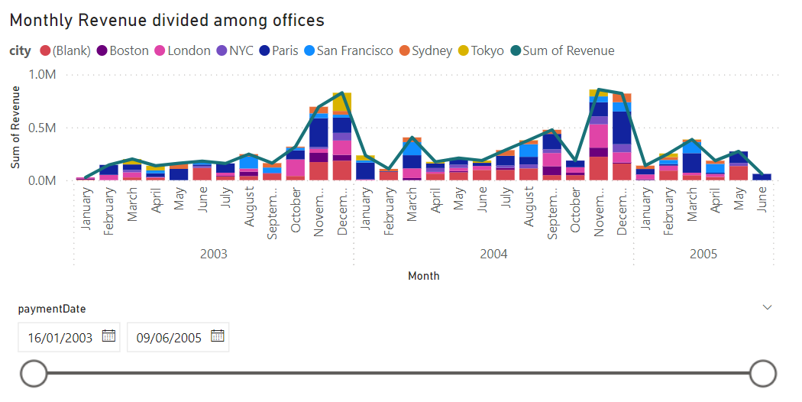
Diagnostic Analysis
Why did certain offices underperform compared to others in the same time period?
It is important to consider that there are three offices based in the United States competing against each other for the same regional market. The reason they underperform alone is likely due to this reason and they should be considered as a triad.
.

Slide 9
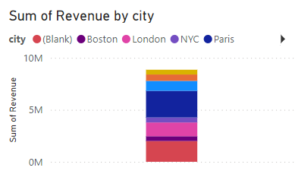
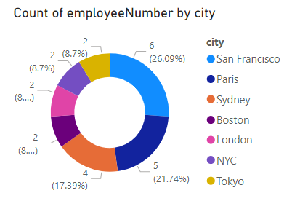
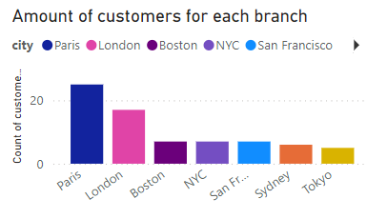
Diagnostic Analysis
Tokyo is also largely underperforming at a glance, though with an office consisting of only two employees, it is natural that they wouldn’t be able to compete with offices that have triple that amount. It may be worth considering hiring more employees for underperforming offices, as the size of the office largely correlates with the revenue they bring in.

Slide 10
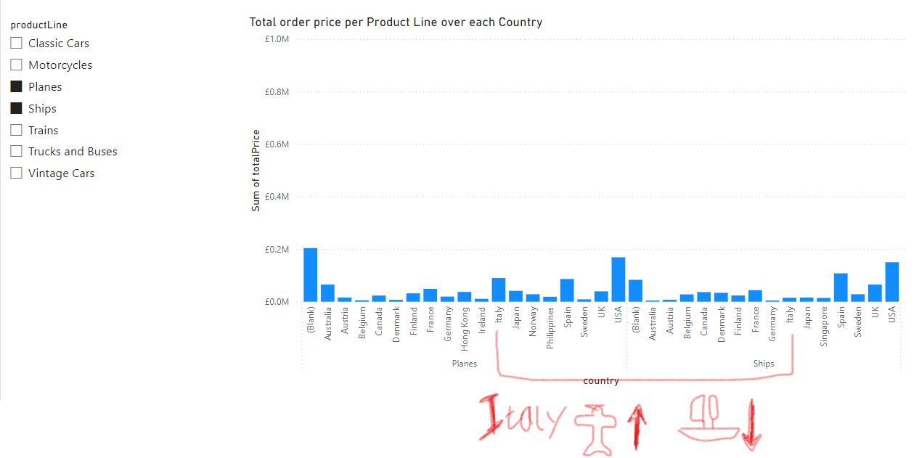
Diagnostic Analysis
Why are specific product lines more popular in some regions compared to others?
While the size of certain countries may directly impact the amount of goods sold in certain areas like the US, some countries seem to have preferences for certain product lines that stand apart from the general trends,
For instance, Italy buys vastly more planes than ships and is one of the top buyers overall for this product line. We can’t say for sure what drives this fascination, but it would be worth researching why they may be popular.

Slide 11
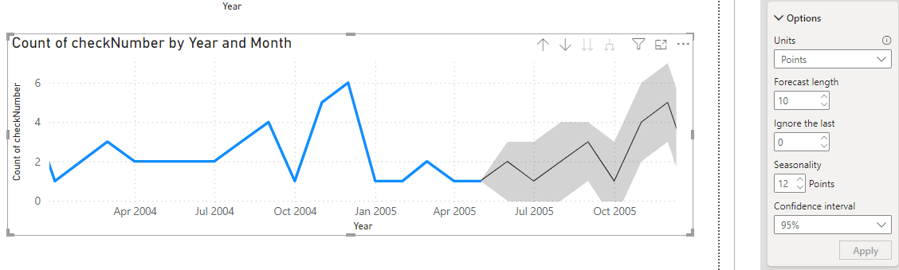

Predictive Analysis
These questions required me to utilise forecasting, a powerful tool you can use to predict results over a speculative amount of time, factoring potential upper and lower bounds to help encourage careful decision making and preparation into the future of a business.

Slide 12
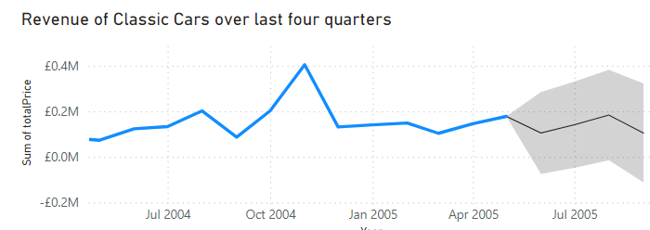
Predictive Analysis
Based on the average revenue growth of the last four quarters, what is the expected revenue for the next quarter for the top performing product line (classic cars)?
Factoring in that the last payment received was from May, looking at a period from June 2005 – September 2005, the expected revenue is due to fall to lower levels before returning to their current levels in August. It is likely that we won’t experience a large rise in revenue until the final quarter of that year.

Slide 13
Predictive Analysis
Which customer segment, based on their order count over the last year, are predicted to increase the number of bulk orders over time?
Customers in Asia and Australia are predicted to be the most frequent buyers in the 6 month forecast alongside buyers in North America, with upwards of 5-6 bulk orders predicted for November 2005.

Slide 14
What I’d do differently
While I am satisfied with the level of analysis I was able to go into for this dataset, next time I would like to find a way to accommodate the orders with no connection to any sales reps and make them a separate controllable ‘office’, preferably through changing any null values in that specific field to something that can be tracked by another record in the offices table. Otherwise, they would appear as ‘(Blank)’.

